Slide 1
World History
Pre-civilization to
Agricultural Revolution

Slide 2
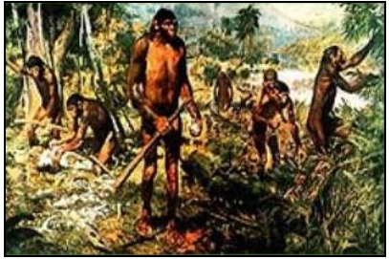

Life
200,000 years ago looked something like this.
Homo erectus doing lunch
Human Origins
200,000 yrs ago
10,000 years ago
Today

Slide 3
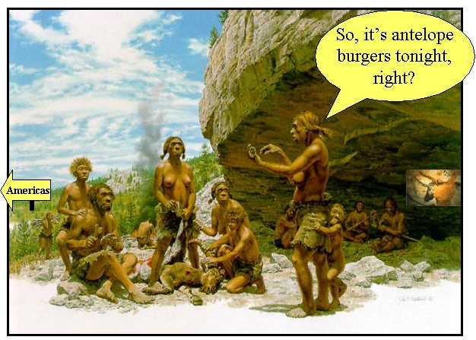

10,000 years ago, life looked more like this:
Homo sapiens at home
Human Origins
200k yrs ago
10k years ago
Today

Slide 4

Notice any changes?
Homo erectus – 200,000 years ago
Homo sapiens – 10,000 years ago

Slide 5
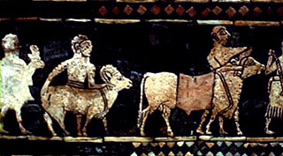
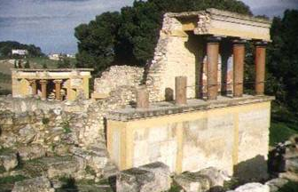
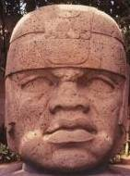
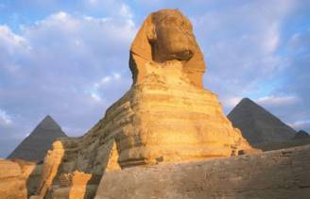
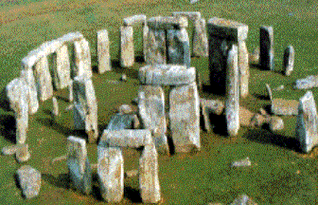
Beginning about
3500 B.C.,
these changes
happened
Notice any
Differences?
So, how did we get from there to here?

Slide 6
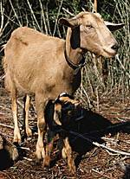
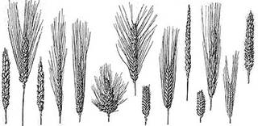
DOMESTICATION of…
animals
and plants
Resulted in a new way of living we know as FARMING.
“The Agricultural Revolution”
1.) Crop growing
2.) Herding animals
…and the development of
3.) FARMING COMMUNITIES

Slide 7
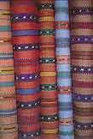
This means more people – Population centers around food growing areas around the world.
Reliable food source also means more food – a SURPLUS!
…this allows people to specialize in jobs other than growing crops and herding animals, like:
Weavers
Stone Masons
Potters
Priests
Scribes
Traders
Army officers

Slide 8
Domestication of Plants and Animals
Farming
Population
Intensification
Surplus Food
Specialization
Complex Society,
also known as
CIVILIZATION

Slide 9
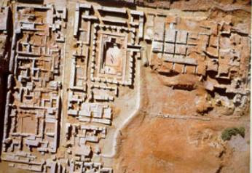
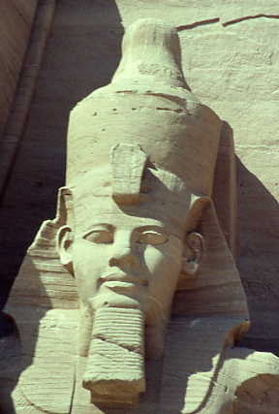
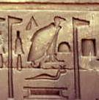
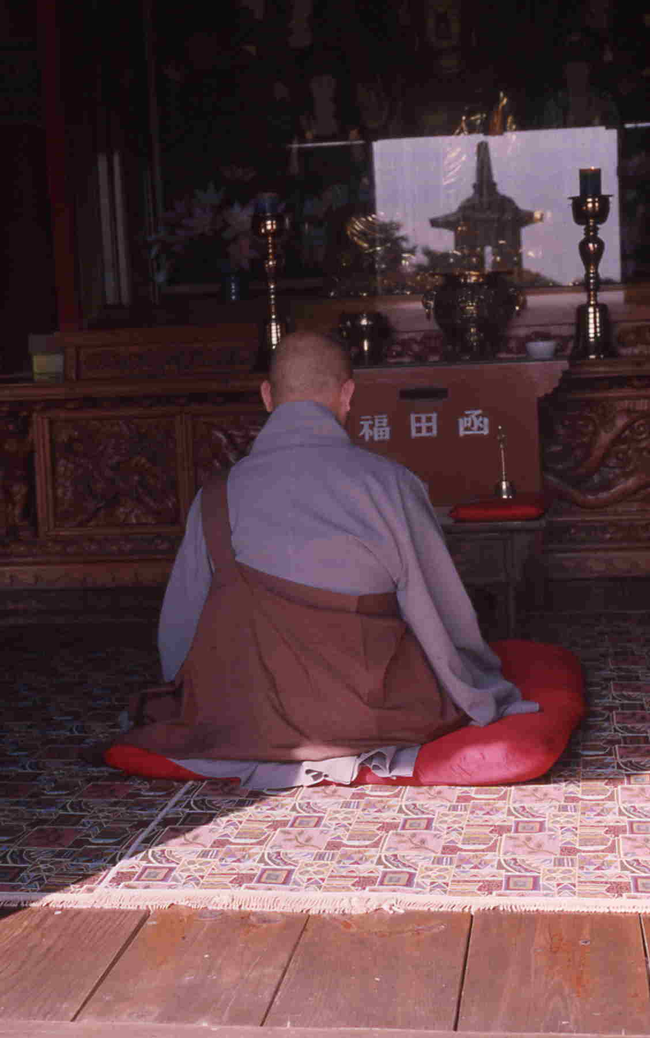
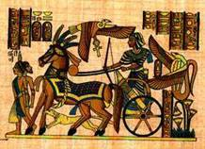
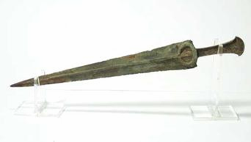
Elements of Civilization include:
City of: Mohenjo Daro
1) Cities
2) Central governments and law codes
3) Writing and record keeping
4) Highly organized religion
Writing and Laws
5) Specialized jobs
Pharaohs
6) Social classes
7) Complex Technologies
Priest
Chariot
Bronze Sword

Slide 10
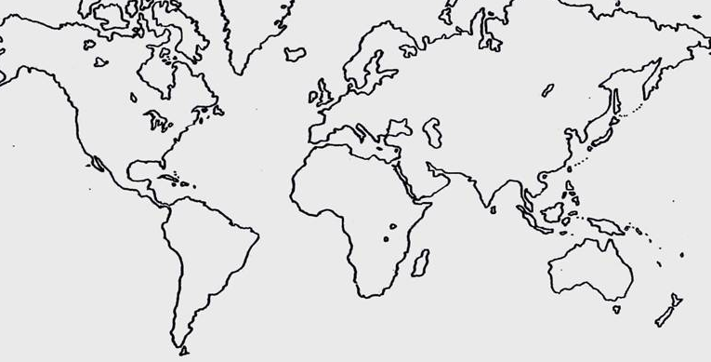
Eastern North America
China
Fertile Crescent
Nile valley
Indus Valley
Mesoamerica
West
Africa
Ethiopia
New Guinea
Andes
Amazonia

